Slide 1
Introduction
We all have our favorite sports, but which sports are the most popular around the world? Soccer is widely popular game across all sports in the world. It is being followed by over 30 billion people.
This Data Set Includes:
+25,000 matches
+10,000 players
11 European Countries with their lead championship
Seasons 2008 to 2016
Players and Teams' attributes* sourced from EA Sports' FIFA video game series, including the weekly updates
Team line up with squad formation
Detailed match events (goal types, possession, corner, cross, fouls, cards etc...) for +10,000 matches

Slide 2
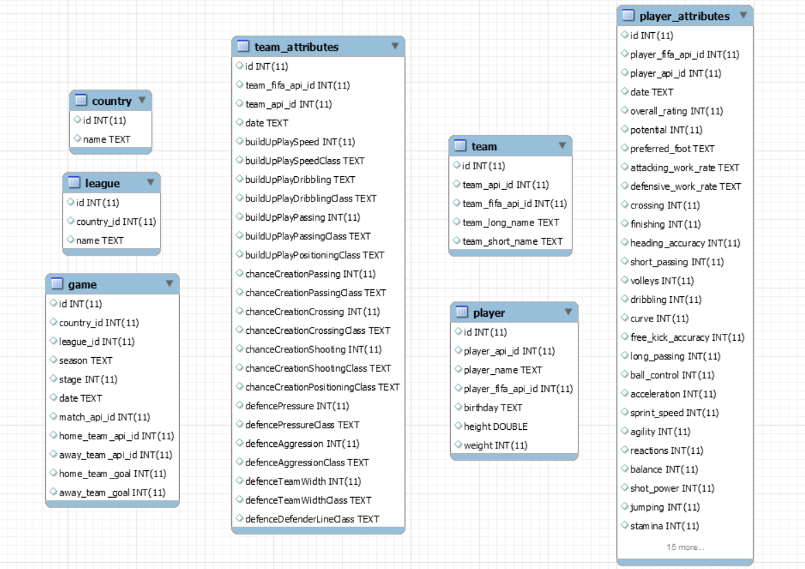
Important Tables
Country
League
Game
Team
Team Attributes
Player
Player Attributes

Slide 3
Column Definitions
Country: This table consists of columns which are country_id, country_name which gives us the detailed information about the countries involved in soccer
League: This table says about the different leagues organized by each country and has id, country_id, name
player : Gives us the detailed information about the player_name, birthday, height and weight etc
player_attributes : Gives us the skill set of each player like (crossing, finishing, passing, shooting etc)
Team: Different teams. And gives us the information about team_api_id, team_long_name
Team_attributes: This table includes the skill set of the team. There are lot of columns in Team_attributes.
Few of them are playspeed, dribbling etc.
Game: This table contains different games played. The columns are match_api_id, country_id, league_id etc.

Slide 4
Highest Goals by each team in every season?
SQL SCRIPT:
select g4.season,g5.TeamId,g4.max_total_sum
from
(SELECT season, MAX(TotalGoals) max_total_sum
FROM
(SELECT
TeamId, SUM(TeamGoals) AS TotalGoals, season
FROM
(SELECT
season ,
home_team_api_id AS TeamId,
SUM(home_team_goal) AS TeamGoals
FROM
games where home_team_goal!=0
GROUP BY TeamId , season UNION SELECT
season,
away_team_api_id AS TeamId,
SUM(away_team_goal) AS TeamGoals
FROM
games where away_team_goal!=0
GROUP BY TeamId , season) t1
GROUP BY season,TeamId) g3
group by season ) g4
JOIN
(SELECT
TeamId, SUM(TeamGoals) AS TotalGoals, season
FROM
(SELECT
season ,
home_team_api_id AS TeamId,
SUM(home_team_goal) AS TeamGoals
FROM
games where home_team_goal!=0
GROUP BY TeamId , season UNION SELECT
season,
away_team_api_id AS TeamId,
SUM(away_team_goal) AS TeamGoals
FROM
games where away_team_goal!=0
GROUP BY TeamId, season) t2
GROUP BY season,TeamId) as g5 on g4.season=g5.season
and g4.max_total_sum=g5.TotalGoals order by season,max_total_sum;

Slide 5
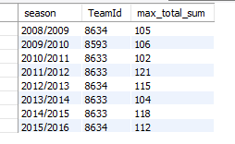
Highest Goals by each team in every season?
RESULT:
We can predict the strongest team or winners by analyzing the winners across all the seasons.

Slide 6
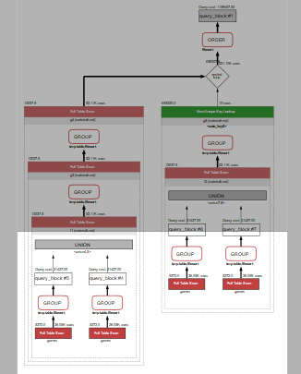
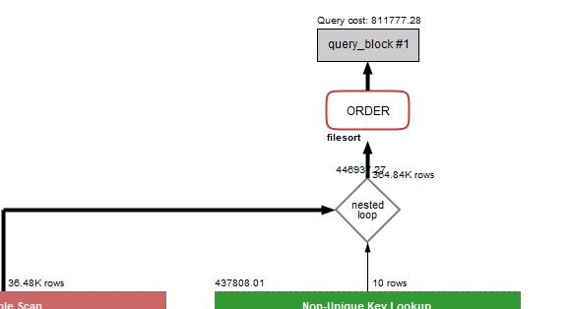
Highest Goals by each team in every season?
INDEXING:

Slide 7
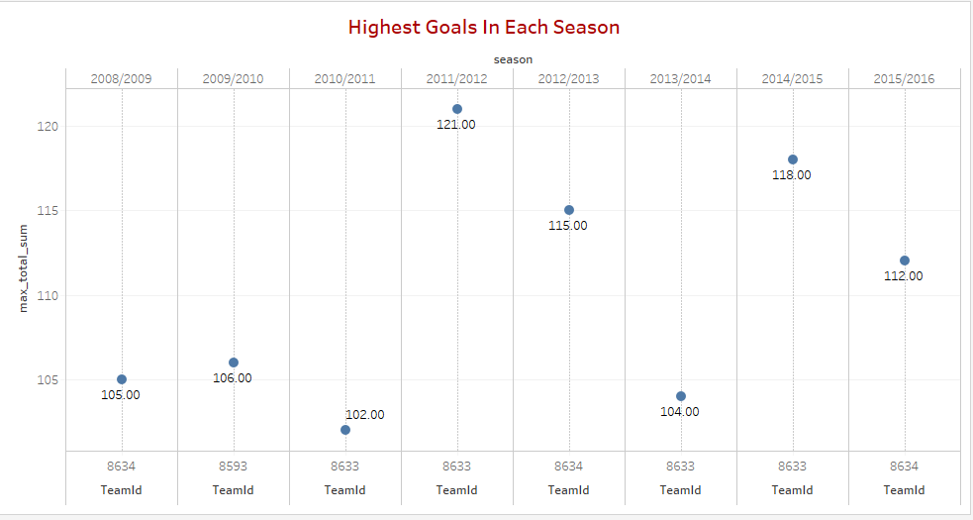
Highest Goals by each team in every season?
VISUALIZATION

Slide 8
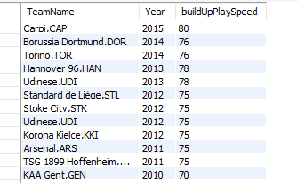
Team with highest BuildUpPlaySpeed per Year
SQL SCRIPT:
SELECT
CONCAT(team_long_name, ',', team_short_name) AS TeamName,
EXTRACT(YEAR FROM t1.date) AS Year,
buildUpPlaySpeed
FROM
team
INNER JOIN
team_attributes ON team.team_api_id = team_attributes.team_api_id
INNER JOIN
(SELECT
MAX(buildUpPlaySpeed) maxbuildup, team_attributes.date
FROM
team_attributes
WHERE
team_attributes.date = team_attributes.date
GROUP BY team_attributes.date) t1
WHERE
buildUpPlaySpeed = t1.maxbuildup
AND team_attributes.date = t1.date
ORDER BY t1.date DESC;
RESULT:
Play Speed is one of the most important attribute to achieve Soccer Excellence.

Slide 9
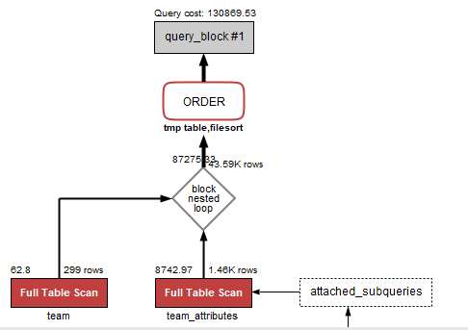
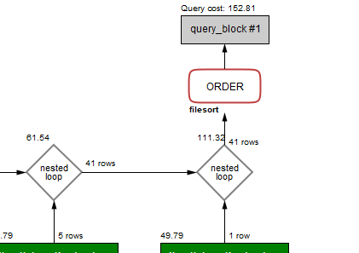
Highest BuildUpPlaySpeed per Year
INDEXING:

Slide 10
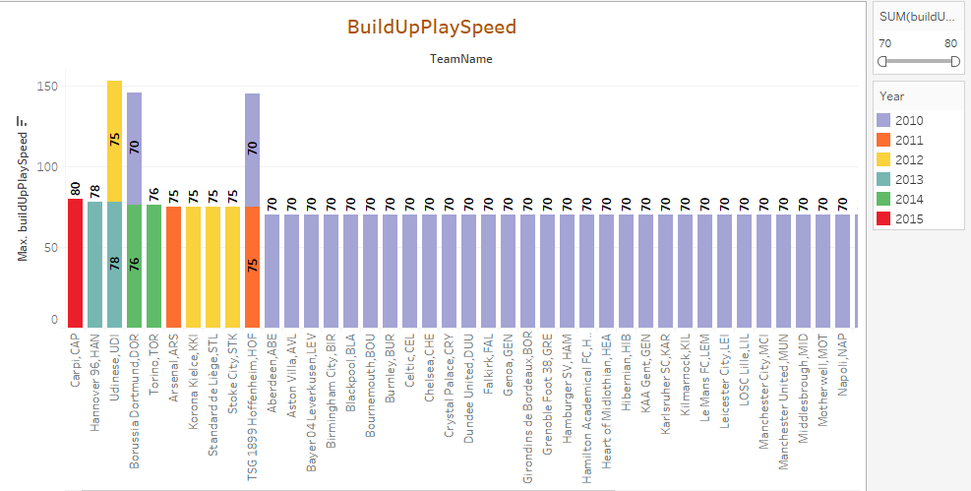
Highest BuildUpPlaySpeed per Year
VISUALIZATION

Slide 11
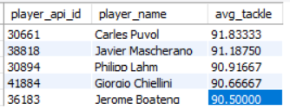
Players with best tackling rate
SQL SCRIPT:
SELECT
p.player_api_id, p.player_name, k.avg_tackle
FROM
player p
JOIN
(SELECT
pa.player_api_id,pa.standing_tackle + pa.sliding_tackle,
AVG((pa.standing_tackle + pa.sliding_tackle) * 0.5) AS avg_tackle
FROM
player_attributes pa
WHERE
pa.sliding_tackle > 90
AND pa.standing_tackle > 80
GROUP BY pa.player_fifa_api_id
) k ON p.player_api_id = k.player_api_id
ORDER BY avg_tackle DESC
LIMIT 5;
RESULT:
Tackling determines the defence of a team

Slide 12
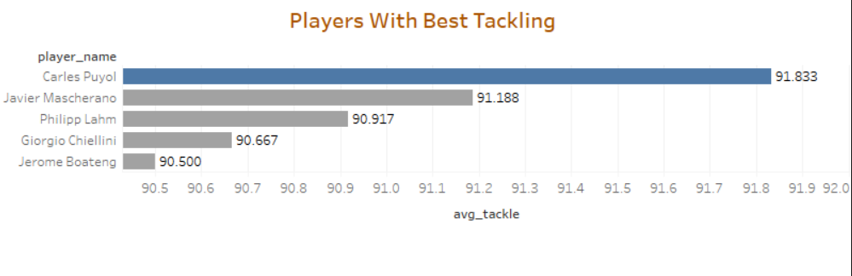
Players with best tackling rate
VISUALIZATION

Slide 13
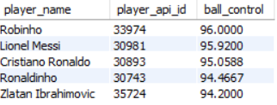
Players with best ball control rate
SQL SCRIPT:
RESULT:
SELECT
p.player_name,
pa.player_api_id,
AVG(pa.ball_control) AS ball_control
FROM
player_attributes pa
JOIN
player p ON pa.player_api_id = p.player_api_id
WHERE
pa.ball_control > (SELECT
AVG(paa.ball_control)
FROM
player_attributes paa
WHERE
player_api_id = 30955
GROUP BY player_api_id)
GROUP BY pa.player_api_id
ORDER BY ball_control DESC
LIMIT 5;
Ball control is the essential skill to be a effective player

Slide 14
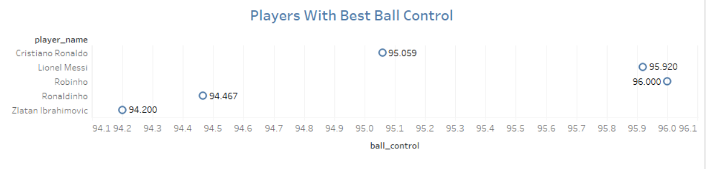
Players with best ball control rate
VISUALIZATION

Slide 15

Player with best goal keeping attributes
SQL SCRIPT:
RESULT:
SELECT
p.player_api_id AS 'Player ID',
p.player_name AS 'Player Name',
AVG((pa.gk_diving + pa.gk_handling + pa.gk_kicking + pa.gk_positioning + pa.gk_reflexes) / 5) AS 'Goal Statistics'
FROM
player p,
player_attributes pa
WHERE
p.player_api_id = pa.player_api_id
AND p.player_api_id IN (SELECT
player_api_id
FROM
player_attributes
GROUP BY player_api_id
HAVING AVG((gk_diving + gk_handling + gk_kicking + gk_positioning + gk_reflexes) / 5) > 85
ORDER BY player_api_id);
A goalkeeper is the only player between
the goal and the striker

Slide 16
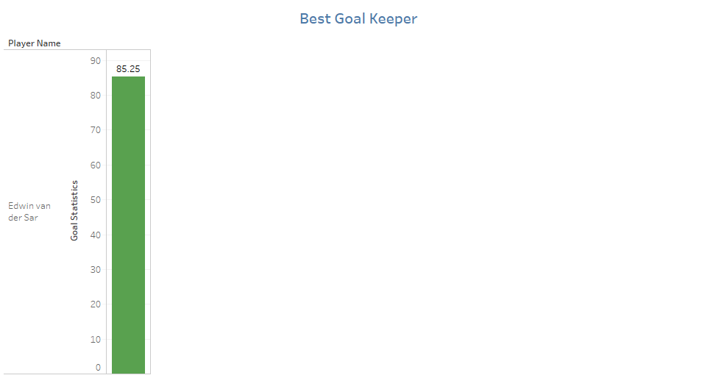
Player with best goal keeping attributes
VISUALIZATION

Slide 17
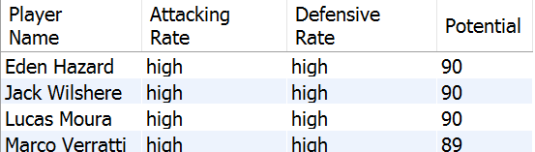
Players with high Attack and Defence work rate
RESULT:
SQL SCRIPT:
SELECT p.player_name AS 'Player Name', pa.attacking_work_rate AS 'Attacking Rate',
pa.defensive_work_rate AS 'Defensive Rate', pa.potential AS 'Potential'
FROM player p, player_attributes pa
WHERE p.player_api_id = pa.player_api_id and pa.attacking_work_rate = 'high' AND pa.defensive_work_rate='high'
GROUP BY player_name
HAVING potential IN
(SELECT potential
FROM player_attributes pa
WHERE potential>88
ORDER BY potential DESC)
ORDER BY pa.potential DESC;
Attack work rate and Defensive work rate of the players defines the range and positioning of the player during the match

Slide 18
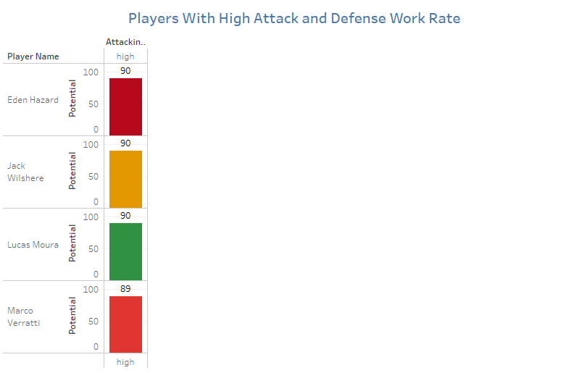
Players with high Attack and Defence work rate
VISUALIZATION

Slide 19
Overall Goals made by each team
SQL SCRIPT:
SELECT t.team_long_name AS 'Team Name',
M.Goals AS 'Total Goals Scored'
FROM games g
JOIN team t
ON g.home_team_api_id = t.team_api_id
OR g.away_team_api_id = t.team_api_id
JOIN ( SELECT t.team_api_id, (SUM(g.away_team_goal) + SUM(g.home_team_goal)) as 'Goals'
FROM games g, team t
WHERE g.home_team_api_id = t.team_api_id
OR g.away_team_api_id = t.team_api_id
GROUP BY t.team_api_id
ORDER BY (SUM(g.away_team_goal) + SUM(g.home_team_goal)) DESC) M
ON t.team_api_id = M.team_api_id
GROUP BY t.team_api_id
ORDER BY M.Goals DESC, team_long_name ASC;
.

Slide 20
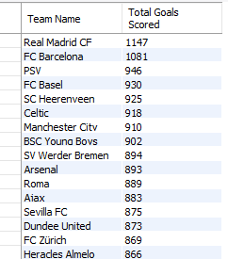
Total Goals made by each team
RESULT:
Every team keeps scoring goals in every match and the team with highest goals will always stands in top

Slide 21
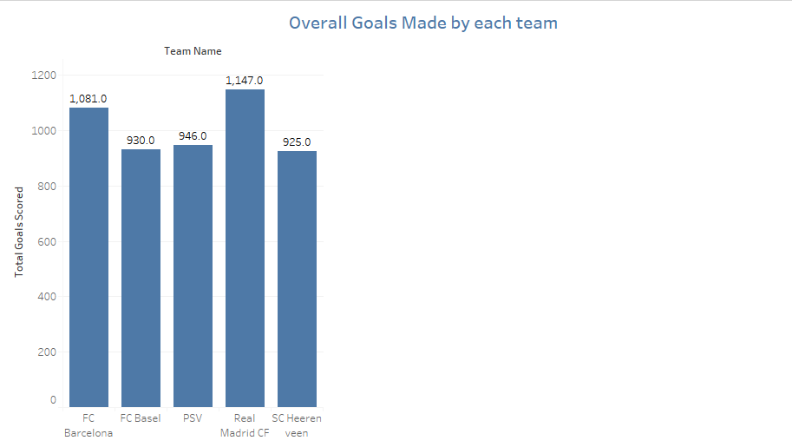
Overall Goals made by each team
VISUALIZATION

Slide 22
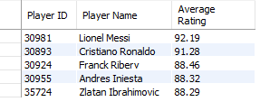
Top 5 players as per their average overall rating
SQL SCRIPT:
RESULT:
SELECT
p.player_api_id AS 'Player ID',
p.player_name AS 'Player Name',
ROUND(t1.Average, 2) AS 'Average Rating'
FROM
player p
JOIN
(SELECT
player_api_id, AVG(overall_rating) AS 'Average'
FROM
player_attributes
GROUP BY player_api_id
HAVING AVG(overall_rating) > 85) t1 ON p.player_api_id = t1.player_api_id
ORDER BY t1.average DESC
LIMIT 5;
Average overall rating is considered by comparing the player skills in all games

Slide 23
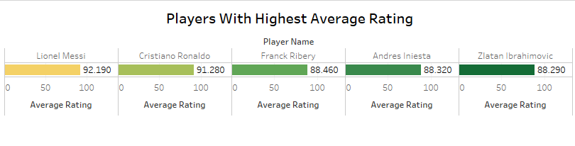
Top 5 players as per their average overall rating
VISUALIZATION

Slide 24

Thank you
Thankyou

